Slide 1

Java memory management
Dima Ionut Daniel

Slide 2
Contents
What is Java ?
History
The Stack
The Heap
Values and References
Garbage Collection
Tuning the Virtual Machine
Bibliography

Slide 3

What is Java ?
Java is a programming language created by Sun Microsystems.
Java is used in a wide variety of computing platforms from embedded devices and mobile phones on the low end, to enterprise servers and supercomputers on the high end.
Memory management is handled through integrated automatic garbage collection performed by the JVM.

Slide 4
What is Java ? (cont.)
The heart of the Java platform is the concept of a "virtual machine" that executes Java bytecode programs. This bytecode is the same no matter what hardware or operating system the program is running under.
There is a JIT(Just-In-Time) compiler within the Java Virtual Machine, or JVM. The JIT compiler translates the Java bytecode into native processor instructions at run-time and caches the native code in memory during execution.
The Java programs are cross-platform or platform independent, but the code of the Java Virtual Machines (JVM) that execute these programs is not.

Slide 5
History
The initial Java release was named Oak, and the first stable version was JDK 1.0.2, called Java 1.
JDK 1.0 - 23 January 1996
JDK 1.1 – 19 February 1997
J2SE 1.2 – 8 December 1998 (codename Playground)
J2SE 1.3 – 8 May 2000 (codename Kestrel)
J2SE 1.4 – 6 February 2002 (codename Merlin)
J2SE 5.0 – 30 September 2004 (codename Tiger)
Java SE 6 – 11 December 2006 (codename Mustang)

Slide 6
History (cont.)
Java SE 7 – 7 July 2011(codename Dolphin)
Java SE 8 – 18 March 2014 (codename Spider)
Java SE 9 – 21 September 2017
Java SE 10 – 20 March 2018
Java SE 11 – 25 September 2018
Java SE 12 – 19 March 2019
Java SE 13 – 17 September 2019

Slide 7
The stack
Used for static memory allocation and the execution of a thread
It contains primitive values specific to a method and references to objects that are in a heap
Access to this memory is in LIFO (Last-In-First-Out) order
Access to this memory is fast when compared to heap memory
This memory is threadsafe as each thread operates in its own stack
If this memory is full, Java throws java.lang.StackOverFlowError

Slide 8
The Heap
The heap is used for dynamic memory allocation for objects and classes at the runtime
New objects are always created in heap space and the references to the objects are stored in stack memory
The memory model is divided into smaller parts called generations:
young generation: new objects are allocated and aged. A minor GC occurs when this fills up
old/tenured generation: long surviving objects are stored
permanent generation: JVM metadata for the runtime classes and application methods

Slide 9
The Heap (cont.)
Accessed via complex memory management techniques that include Young Generation, Old or Tenured Generation, and Permanent Generation
If heap space is full, Java throws java.lang.OutOfMemoryError
Access to this memory is relatively slower than stack memory
Unlike stack, a heap isn't threadsafe and needs to be guarded by properly synchronizing the code
This memory, in contrast to stack, isn't automatically deallocated. It needs Garbage Collector to free up unused objects to keep the efficiency of the memory usage

Slide 10
Values and References
Pass-by-value:
the actual argument is fully evaluated, and the resulting value is copied into a location being to hold the formal parameter's value during method execution
Pass-by-reference:
the formal parameter merely acts as an alias for the actual parameter for reading and writing

Slide 11
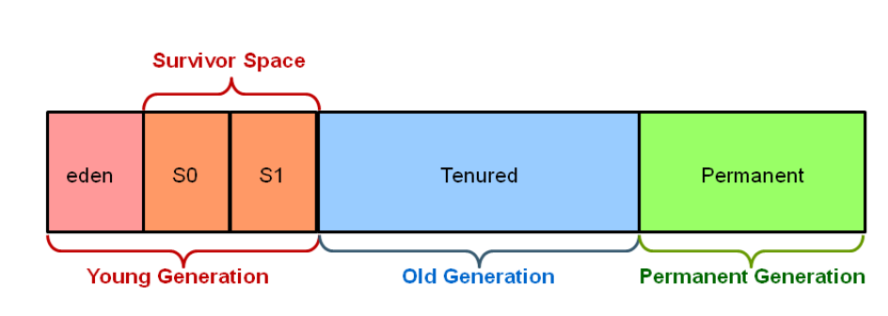
Garbage Collection
Automatic garbage collection is the process of looking at heap memory, identifying objects that are in use and deleting the unreferred objects.
In Java, process of deallocating memory is handled automatically by the garbage collector.
The heap parts are: Young Generation, Old/Tenured Generation, Permanent Generation.

Slide 12
Garbage Collection (cont.)
The young generation is where all new objects are allocated and aged.
A young generation full of dead objects is collected very quickly.
Some surviving objects are aged and moved to the old generation.

Slide 13
Garbage Collection (cont.)
The Old Generation is used to store long surviving objects.
When the old generation needs to be collected, the event is called "major garbage collection".
The Permanent Generation contains metadata required by the JVM to describe the classes and methods used in the application.
In addition, Java SE library classes and methods may be stored here.

Slide 14
Garbage Collection (cont.)
Any object on the heap which cannot be reached though a reference from the stack is "eligible for garbage collection".
System.gc() method forces the invocation of garbage collector.

Slide 15
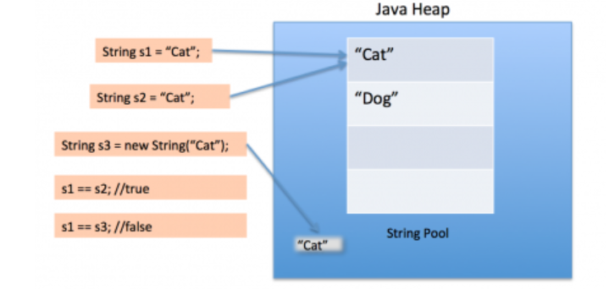
Garbage Collection (cont.)
A string pool in java is a poll of Strings stored in Java Heap memory.
String Pool is possible only because String is immutable in Java and its implementation of String interning concept.
String pool is also example of Flyweight design pattern.
String pool helps in saving a lot of space for Java Runtime although it takes more time to create the String.

Slide 16
Garbage Collection (cont.)
When we use double quotes to create a String, it first looks for String with the same value in the String pool. It it founds it just returns the reference, else it creates a new String in the pool and then returns the reference.
Using new operator, we force String class to create a new String object in heap space.
We can use intern() method to put it into the pool or refer to another String object from the string pool having the same value.

Slide 17
Tuning the Virtual Machine
-Xmx → sets the maximum heap size
-Xms → sets the starting heap size
-Xmn → sets the size of the young generation
-XX:HeapDumOnOutOfMemory → creates a heap dump file
-XX:MaxPermSize →sets the size of the permagen
-verbose:gc → prints to the console when a garbage collection takes place
Eg: -Xmx512m , -XX:MaxPermSize=256M

Slide 18
Tuning the Virtual Machine (cont.)
Oracle VM has 3 types of collectors:
Serial : uses only one single thread to collect (-XX:+UseSerialGC)
Parallel: uses multiple threads on young generation section in parallel (-XX:+UseParallelGC)
Mostly Concurrent: performs concurrently, real time GC (-XX:+UseConcMarkSweepGC, --XX:+UseG1GC)
Use –XX:+PrintCommandLineFlags to find out the default one

Slide 19

Bibliography
https://www.baeldung.com/java-stack-heap
http://www.javadude.com/articles/passbyvalue.htm
https://www.journaldev.com/797/what-is-java-string-pool
Java Memory Management - Udemy

